Slide 1
Testing sounds
Start recording
Making sounds
Stop recording
Export to file

Slide 2



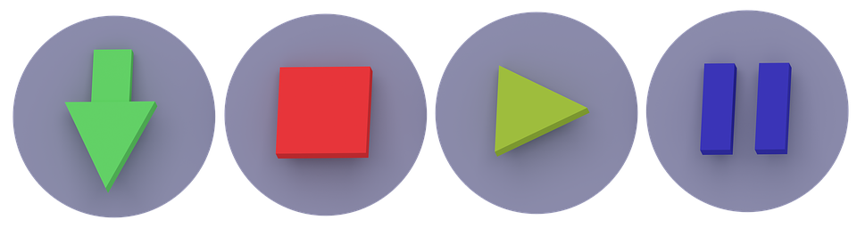
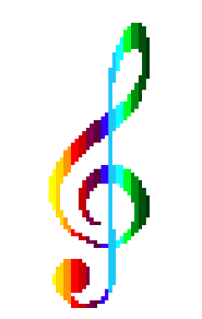
UI scheme – MOCK (Before implementing)
RGB Music
File Help

Slide 3
UI scheme – MOCK (Before implementing)
RGB Music
File Help

Slide 4
UI scheme – MOCK (Before implementing)
RGB Music
File E Help
File
Load images
Settings
Exit

Slide 5

UI scheme – MOCK (Before implementing)
RGB Music
Settings
File E Help
File
Load images
Settings
Exit
Instruments:
Piano
Drums
Violin
Elec. guitar
Classic guitar
Amplitude:
Min
Max
Radius:
15

